Slide 1
Representation of Binomial heaps, Operations on Binomial Trees: Finding the minimum Key,
Uniting the Binomial heaps
By
Mr. Gururaj
Assistant Professor-Selection Grade
Department of Computer Science & Engineering
M.I.T Manipal

Slide 2
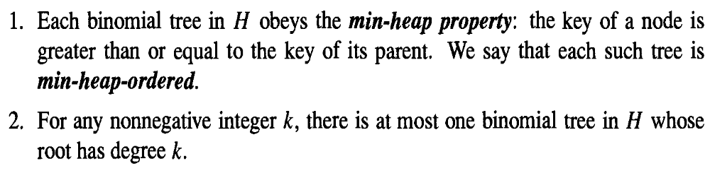
Representation of Binomial Heaps

Slide 3
Representation of Binomial heaps
Each binomial tree within a binomial heap is stored in the left-child, right-sibling representation.
Each node has key field.
Each node x contains pointer p[x] to its parent, child[x] to its leftmost child and sibling[x] to the sibling of x immediately to its right.
If node x is a root, then p[x]=NIL
If node x has no children then child[x]=NIL.
If x is the rightmost child of its parent, then sibling[x]=NIL.
Each node x also contains the field degree[x],which is the number of children of x.

Slide 4
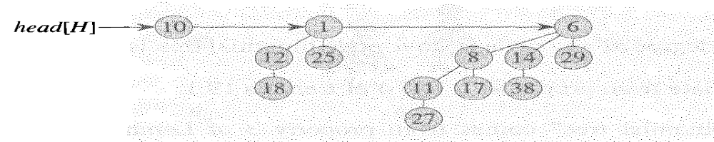
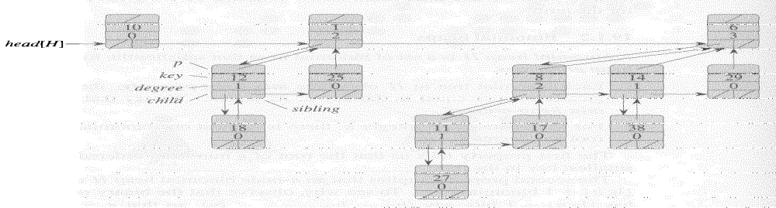
Representation of Binomial heaps
A binomial heap H with n=13 nodes- B₀,B₂ and B₃

Slide 5
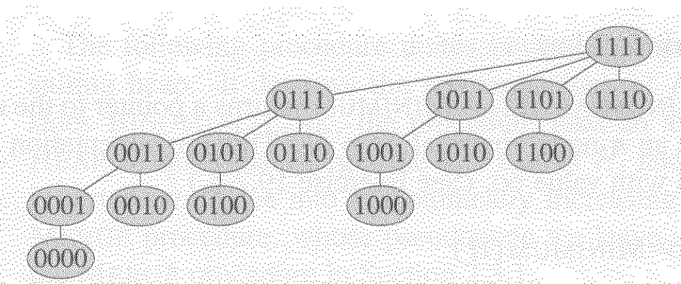
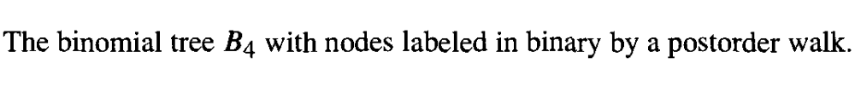
Representation of Binomial heaps

Slide 6
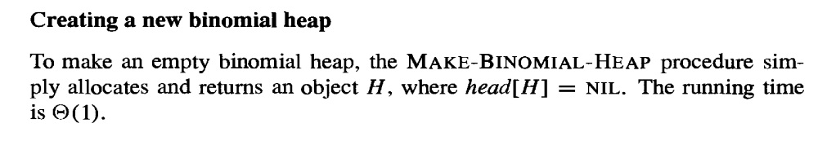

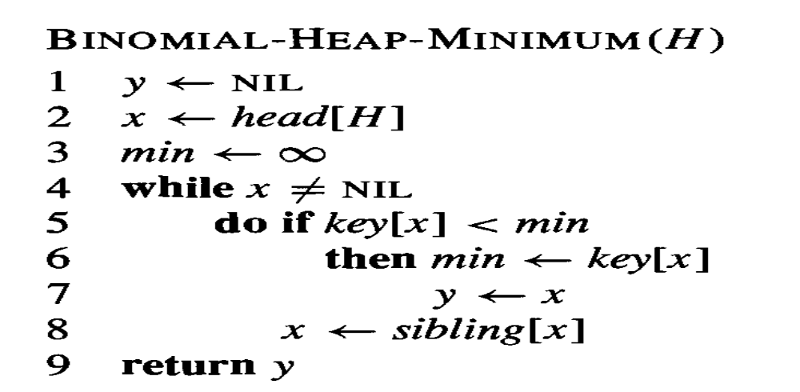
Operations on binomial heap

Slide 7
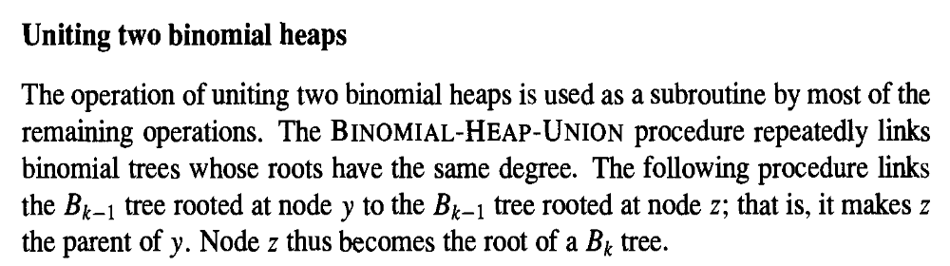
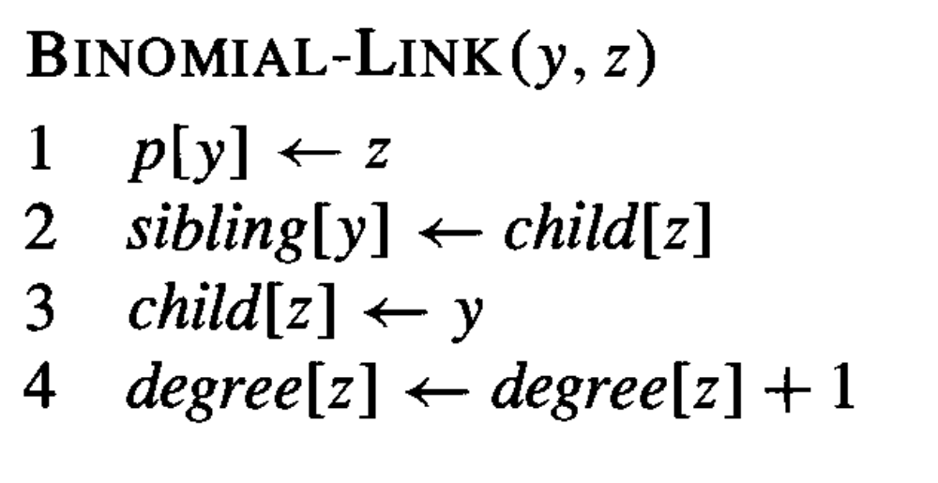
Operations on binomial heap

Slide 8
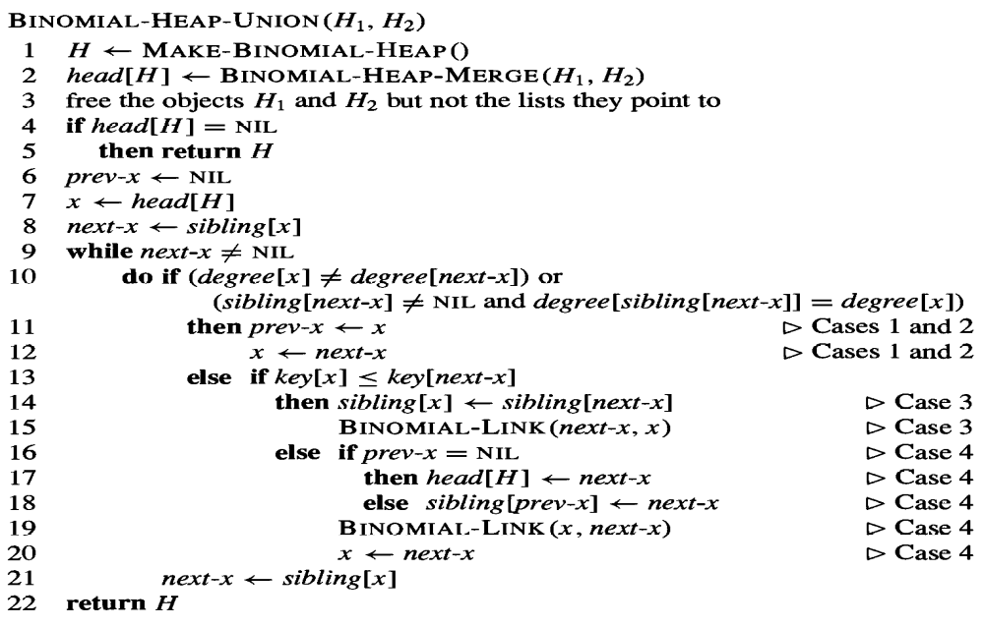
Operations on binomial heap

Slide 9
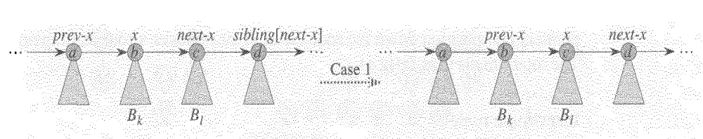
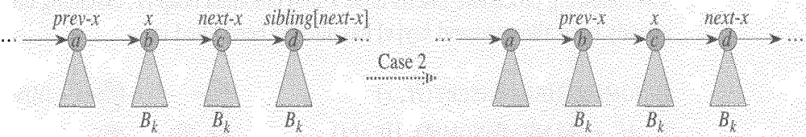
Binomial Heap-Cases

Slide 10
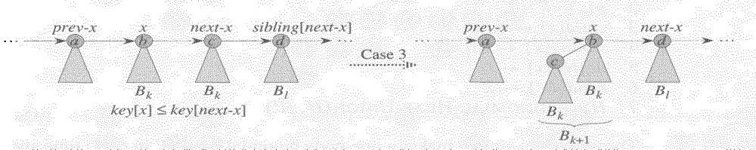
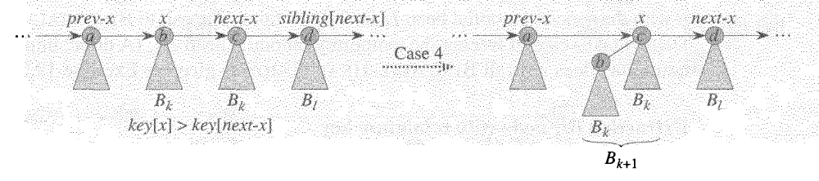
Binomial Heap-Cases

Slide 11
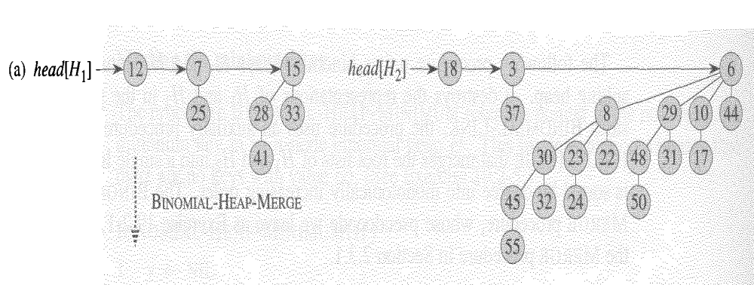
Operations on binomial heap
A
Binomial heaps H1 & H2

Slide 12
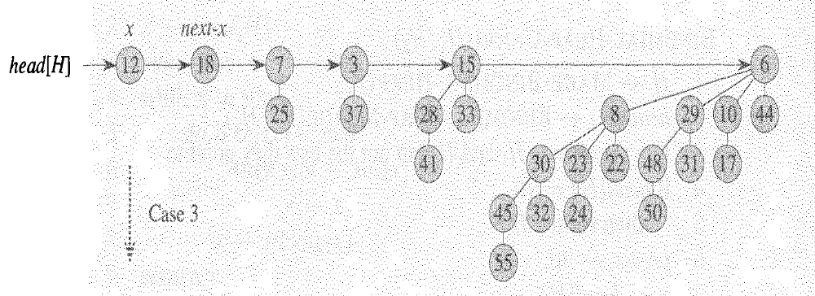
Operations on binomial heap
B
Binomial heap merge -BOTH x and next-x have degree 0 and key[x]<key[next-x]
Case 3 applies

Slide 13
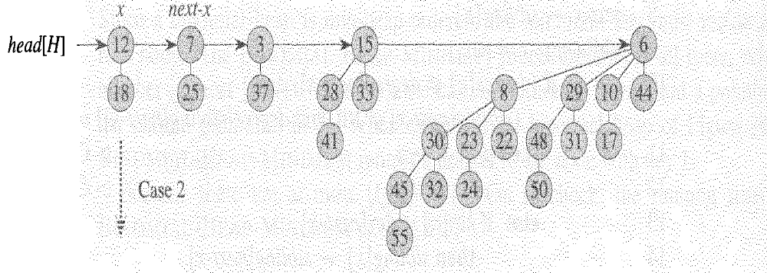
Operations on binomial heap
C
CASE 2 Applies- x is the first 3 of three roots with same degree

Slide 14
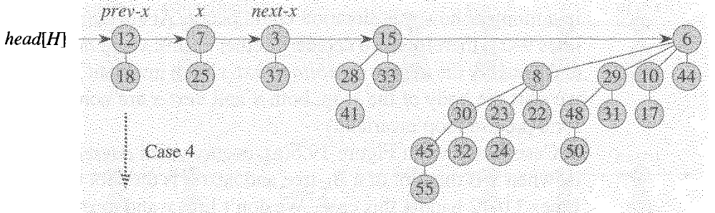
Operations on binomial heap
C

Slide 15
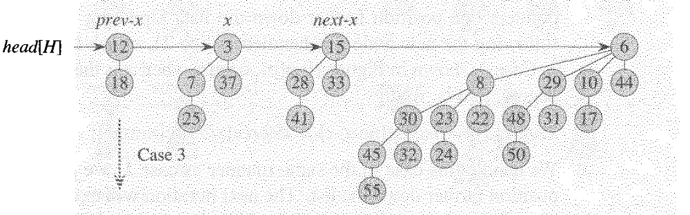
Operations on binomial heap
C

Slide 16
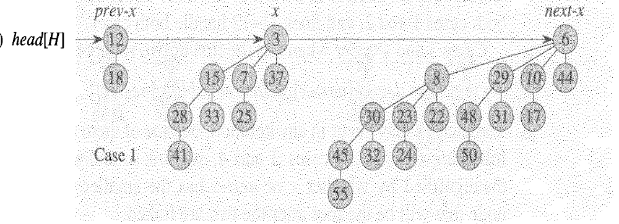
Operations on binomial heap
C

Slide 17
Construct a binomial heap for the list ---30 21 11 27 17 8 19 41 58 18

